Slide 1
Machine Learning
Bianca Furtuna
Technical Evangelist
@Fur_Bi

Slide 2


Slide 3
Descriptive
Predictive
Prescriptive
Intelligent action
What happened?
Why did it happen?
What will happen?
What should I do?

Slide 4
Cortana Intelligence Suite Transform data into intelligent action
Information Management
Big Data Stores
Machine Learning and Analytics
Intelligence
Data Sources
People
Data Factory
Data Lake Store
Machine Learning
Cognitive Services
Data Catalog
SQL Data
Warehouse
Data Lake Analytics
Bot Framework
Web
Apps
HDInsight
(Hadoop and Spark)
Event Hubs
Cortana
Mobile
Apps
Stream Analytics
Bots
Dashboards & Visualizations
Sensors and devices
Power BI
Automated Systems
Data
Intelligence
Action

Slide 5
Machine Learning scenarios
EXAMPLE SOLUTIONS
Sales and marketing
Finance and risk
Customer and channel
Operations and workforce
Customer acquisition
Fraud detection
Lifetime customer value
Pay for performance
Cross-sell and upsell
Credit risk management
Personalized offers
Operational efficiency
Loyalty programs
Product recommendation
Smart buildings
Marketing mix optimization
Predictive maintenance
Supply chain management

Slide 6
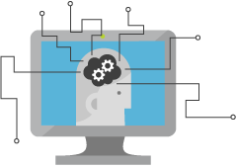
What is Machine Learning?
Computing Systems that become smarter with Experience
Experience = Past Data + Human Input
@Fur_Bi

Slide 7




Why now?
+
+
=

Slide 8
Learning?
Y = aX - b
y = 4.8081x - 56.241
@Fur_Bi

Slide 9
How can Machine Learning bring value?
Machine
Learning
Data
Insights
@Fur_Bi

Slide 10
Questions?
Use maths to answer questions
@Fur_Bi

Slide 11
What type of questions?
Is this class A or class B?
Is this class A or class B or class C or …. class Z?
How much/How many?
Is this anomalous behaviour?
What are the patterns/groupings?
@Fur_Bi

Slide 12
Is this class A or class B?
Is there a face in this image or not?
Will this patient get lung cancer?
Will this machine fail in the next month?
= Two-class/Binary classification
@Fur_Bi

Slide 13
Is this class A or class B or class C or …. class Z?
What object is in this image?
What category best describes this article?
What is the sentiment of the customer comment?
= Multi-class classification
@Fur_Bi

Slide 14
How much/How many?
How much ice-cream will be sold?
How much is the price of this house?
How many hours of use are left for this piece of equipment?
= Regression
@Fur_Bi

Slide 15
Is this anomalous behaviour?
Is this sensor reading out of the normal range?
Is the internet usage unusual?
Is this online transaction unusual?
= Anomaly Detection
@Fur_Bi

Slide 16
What are the patterns/groupings?
Which of my customers have similar spending habits?
How can these news articles be grouped?
Which users have similar movie preferences?
= Clustering
@Fur_Bi

Slide 17
Machine Learning Myths
Machine Learning needs a lot of data
The more features the better
Machine Learning can get insights from any data
Machine Learning replaces human analysts
Machine Learning is all about the model you choose
@Fur_Bi

Slide 18
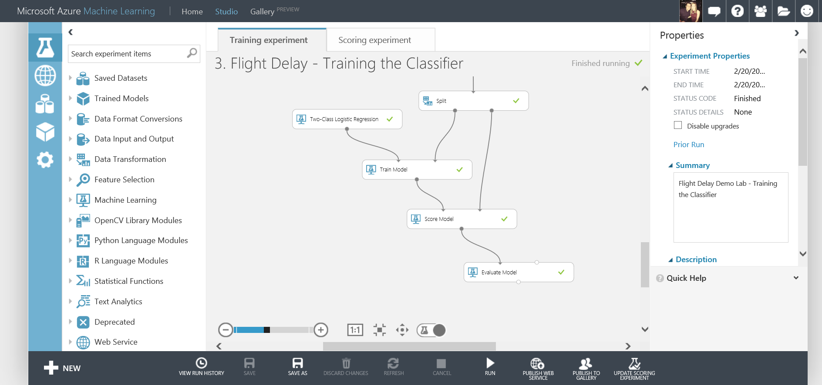
What is Azure Machine Learning?
Fully managed cloud service
Accessed via a browser
Best in class machine learning algorithms
Support for R/Python/SQL
Collaborative data science
Quickly deploy models as web services
Publish to a Gallery

Slide 19
Data
Clients
API
ML STUDIO
Model is now a web service that is callable
Blobs and Tables
Hadoop (HDInsight)
Relational DB (Azure SQL DB)
Integrated development environment for Machine Learning
Monetize the API through our marketplace

Slide 20
Machine Learning Process
Use case
Data
Prep + Build + Test
Publish
Data Preparation
Evaluation
Modelling

Slide 21
Demo
https://studio.azureml.net/
@Fur_Bi

Slide 22
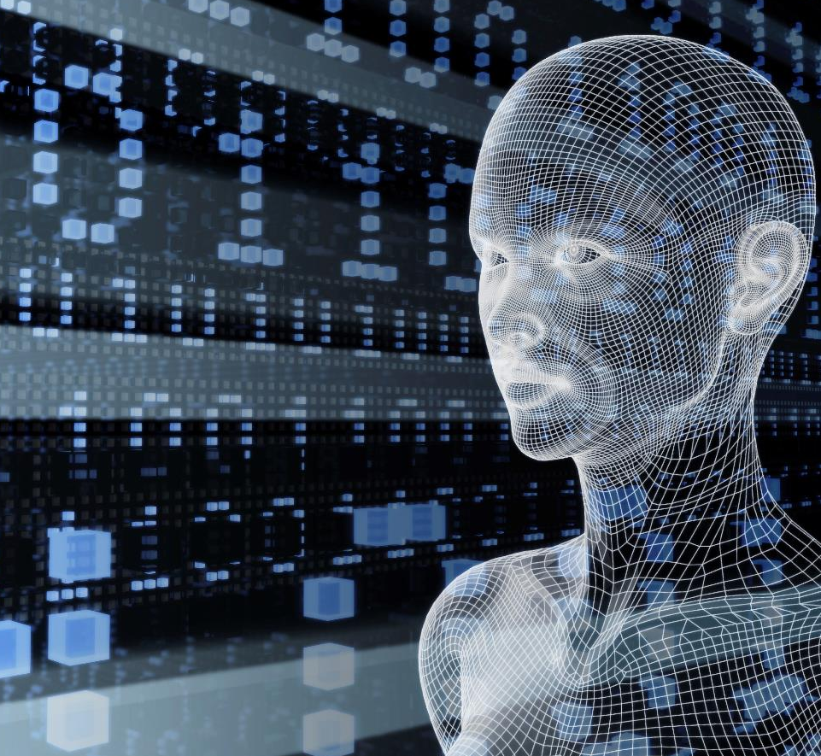
Microsoft Cognitive Services
Vision
From faces to feelings, allow your apps to understand images and video
Cognitive Services
Give your solutions a human side
Speech
Hear and speak to your users by filtering noise, identifying speakers, and understanding intent
Language
Process text and learn how to recognize what users want
Knowledge
Tap into rich knowledge amassed from the web, academia, or your own data
Search
Access billions of web pages, images, videos, and news with the power of Bing APIs

Slide 23
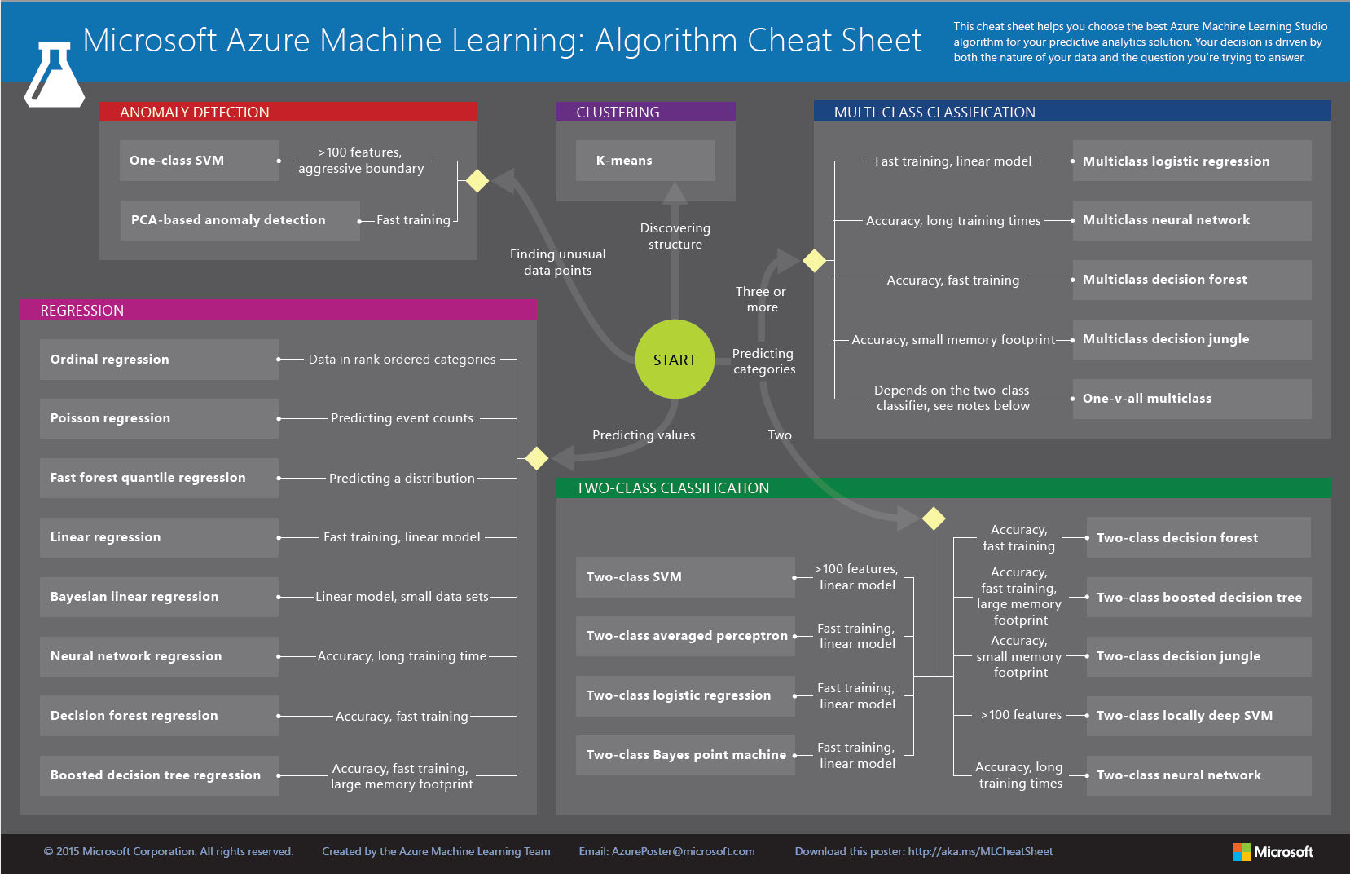

Slide 24

Thank you!
@Fur_Bi
bifurt@microsoft.com
http://furbi.azurewebsites.net/

